Slide 1

Xtra
Years
of
Zest

Slide 2
Marketing Strategy
Discussion

Slide 3
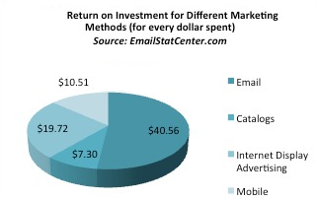

Slide 4
Factors to consider
Number customers
Average purchase amount
Mailing cost
Probability of purchase with catalog
Probability of purchase without catalog

Slide 5
BASE CASE
Planning to launch a two year Catalog Mailing campaign
Types of customers to consider: Existing & Potential Customers
Existing Customers: 1000, who purchased last year & Average purchase amount = $40
Potential Customers: 10,000, who have never purchased
Without Catalog, Existing customer purchasing probability in following years = 15%

Slide 7
Average purchase amount | Year 1 |  |  | Year 2
 | EC | PC | Total number of customers | EC | PC | Total number of customers | Net Profit
$10.00 | 0 | 0 | 0 | 0 | 0 | 0 | $9,360.00
$20.00 | 0 | 0 | 0 | 0 | 0 | 0 | $18,720.00
$21.00 | 1000 | 0 | 1000 | 1300 | 0 | 1300 | $20,001.00
$30.00 | 1000 | 0 | 1000 | 1300 | 0 | 1300 | $31,530.00
$40.00 | 1000 | 0 | 1000 | 1300 | 0 | 1300 | $44,340.00
$60.00 | 1000 | 0 | 1000 | 1300 | 0 | 1300 | $69,960.00
$80.00 | 1000 | 0 | 1000 | 1300 | 0 | 1300 | $95,580.00
$82.00 | 1000 | 10000 | 11000 | 1600 | 0 | 1600 | $98,484.00
$100.00 | 1000 | 10000 | 11000 | 1600 | 0 | 1600 | $128,400.00
$101.00 | 1000 | 10000 | 11000 | 1600 | 9400 | 11000 | $130,344.00
$120.00 | 1000 | 10000 | 11000 | 1600 | 9400 | 11000 | $167,280.00
$130.00 | 1000 | 10000 | 11000 | 1600 | 9400 | 11000 | $186,720.00
$140.00 | 1000 | 10000 | 11000 | 1600 | 9400 | 11000 | $206,160.00

Slide 9
Average Mailing Cost | Year 1 |  |  | Year 2
 | EC | PC | Total number of customers | EC | PC | Total number of customers | Net Profit
$1.00 | 1000 | 10000 | 11000 | 1600 | 9400 | 11000 | $55,760.00
$2.00 | 1000 | 309 | 1309 | 1309 | 0 | 1309 | $46,474.23
$3.00 | 1000 | 0 | 1000 | 1300 | 0 | 1300 | $44,340.00
$4.00 | 1000 | 0 | 1000 | 1300 | 0 | 1300 | $42,040.00
$5.00 | 1000 | 0 | 1000 | 1300 | 0 | 1300 | $39,740.00
$6.00 | 0 | 0 | 0 | 0 | 0 | 0 | $37,440.00
$7.00 | 0 | 0 | 0 | 0 | 0 | 0 | $37,440.00

Slide 10
Purchase Cost | Mailing Cost | Year 1 |  |  | Year 2
 |  | EC | PC | Total number of customers | EC | PC | Total number of customers | Net Profit
$10 | $1 | 1000 | 0 | 1000 | 1300 | 0 | 1300 | $10,510.00
$10 | $2 | 0 | 0 | 0 | 0 | 0 | 0 | $9,360.00
$20 | $1 | 1000 | 0 | 1000 | 1300 | 0 | 1300 | $23,320.00
$20 | $2 | 1000 | 1300 | 2300 | 0 | 0 | 0 | $21,020.00
$20 | $3 | 0 | 0 | 0 | 0 | 0 | 0 | $18,720.00
$30 | $1 | 1000 | 0 | 2300 | 1300 | 0 | 1300 | $37,260.00
$30 | $2 | 1000 | 0 | 2300 | 1300 | 0 | 1300 | $33,830.00
$30 | $3 | 1000 | 0 | 2300 | 1300 | 0 | 1300 | $31,530.00
$30 | $4 | 1000 | 0 | 2300 | 1300 | 0 | 1300 | $29,230.00
$30 | $5 | 0 | 0 | 0 | 0 | 0 | 0 | $28,080.00
$40 | $1 | 1000 | 10000 | 11000 | 1600 | 9400 | 11000 | $55,760.00
$40 | $2 | 1000 | 0 | 1000 | 1300 | 0 | 1300 | $46,640.00
$40 | $3 | 1000 | 0 | 1000 | 1300 | 0 | 1300 | $44,340.00
$40 | $4 | 1000 | 0 | 1000 | 1300 | 0 | 1300 | $42,040.00
$40 | $5 | 1000 | 0 | 1000 | 1300 | 0 | 1300 | $39,740.00
$40 | $6 | 0 | 0 | 0 | 0 | 0 | 0 | $37,440.00
$85 | $1 | 1000 | 10000 | 11000 | 1600 | 9400 | 11000 | $143,240.00
$85 | $2 | 1000 | 10000 | 11000 | 1600 | 9400 | 11000 | $121,240.00
$85 | $3 | 1000 | 10000 | 11000 | 1600 | 0 | 1600 | $103,470.00
$85 | $4 | 1000 | 0 | 1000 | 1300 | 0 | 1300 | $99,685.00
$85 | $5 | 1000 | 0 | 1000 | 1300 | 0 | 1300 | $97,385.00
$85 | $12 | 1000 | 0 | 1000 | 1300 | 0 | 1300 | $81,285.00
$85 | $13 | 0 | 0 | 0 | 0 | 0 | 0 | $79,560.00
$110 | $1 | 1000 | 10000 | 11000 | 1600 | 9400 | 11000 | $191,840.00
$110 | $2 | 1000 | 10000 | 11000 | 1600 | 9400 | 11000 | $169,840.00
$110 | $3 | 1000 | 10000 | 11000 | 1600 | 9400 | 11000 | $147,840.00
$110 | $4 | 1000 | 10000 | 11000 | 1600 | 0 | 1600 | $132,420.00
$110 | $5 | 1000 | 0 | 1000 | 1300 | 0 | 1300 | $129,410.00
$110 | $10 | 1000 | 0 | 1000 | 1300 | 0 | 1300 | $117,910.00
$110 | $16 | 1000 | 0 | 1000 | 1300 | 0 | 1300 | $104,110.00
$110 | $17 | 0 | 0 | 0 | 0 | 0 | 0 | $102,960.00

Slide 11
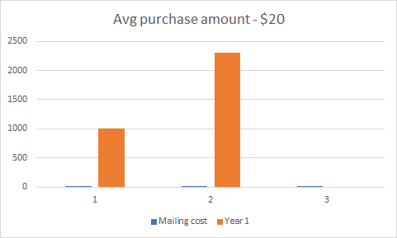
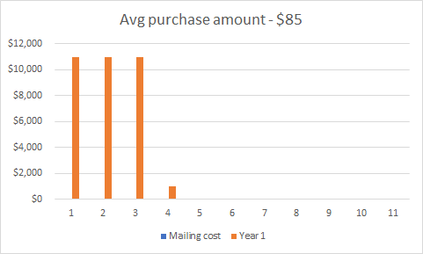
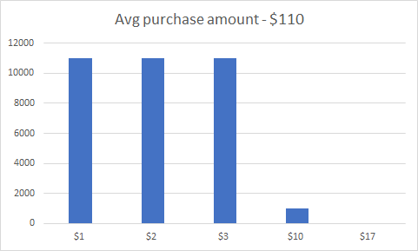

Slide 12
Customers who received catalog
 | Year 1 | Year 2
EC | 1000 | 1309
PC | 300 | 0
No. of EC who purchased | 300 | 393
No. of PC who purchased | 18 | 0
Total number of customers who purchased | 318 | 393

